Slide 1
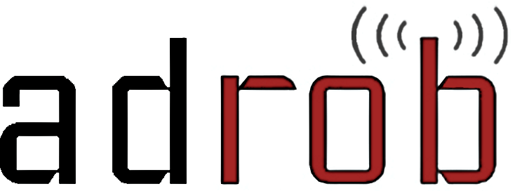
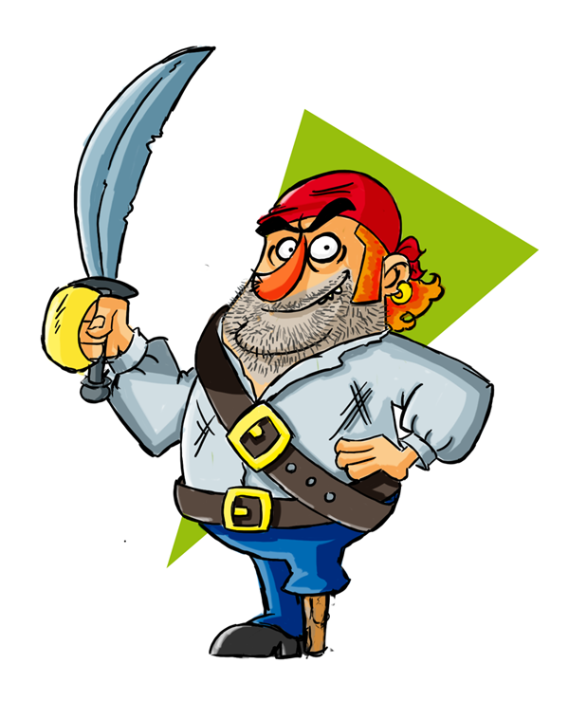


Examining the Landscape and Impact of Android App Plagiarism
Clint Gibler
Ryan Stevens
Jonathan Crussell
Hao Chen
Hui Zang
Heesook Choi

Slide 2





Smartphones Abound

Slide 3
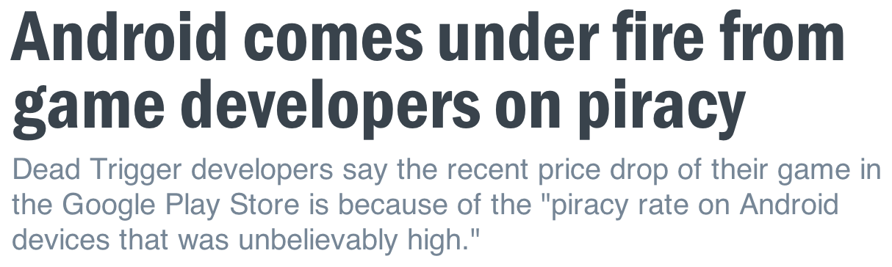
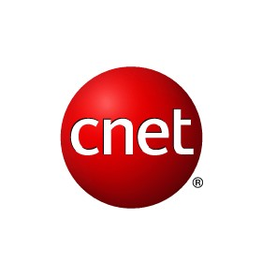

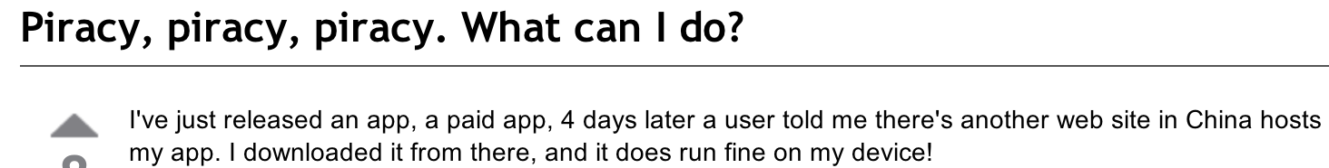

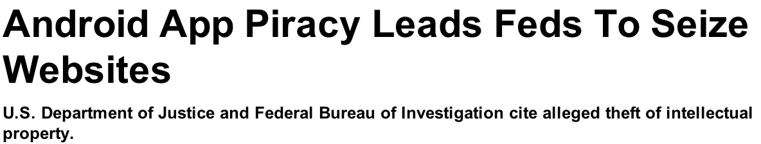

Slide 4
Plagiarism Harms the App Ecosystem
Developers
Lose revenue and incentive to make apps
Markets
Polluted search results
Users
Difficult to find useful, high-quality apps

Slide 5



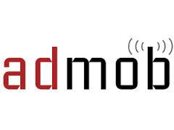

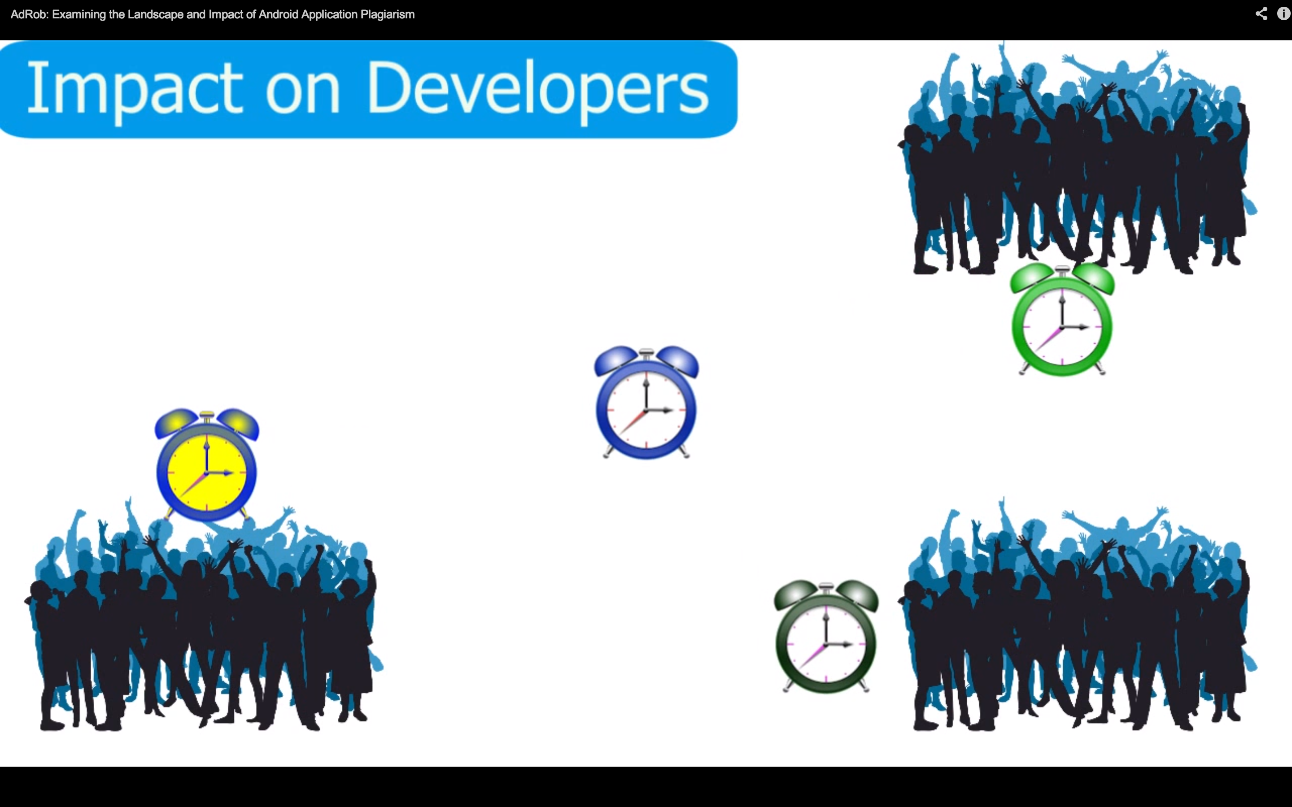
Investigation Goals
Characteristics of cloned apps
Market
App category
Ad provider
Impact on developers
Ad revenue
User base

Slide 6
Definitions
Cloning
Apps with significant code sharing
Plagiarism
Cloned apps by different authors
Owner
Signed and uploaded a given app

Slide 7


Dataset – Android Apps
265,000 apps from 17 markets

Slide 8
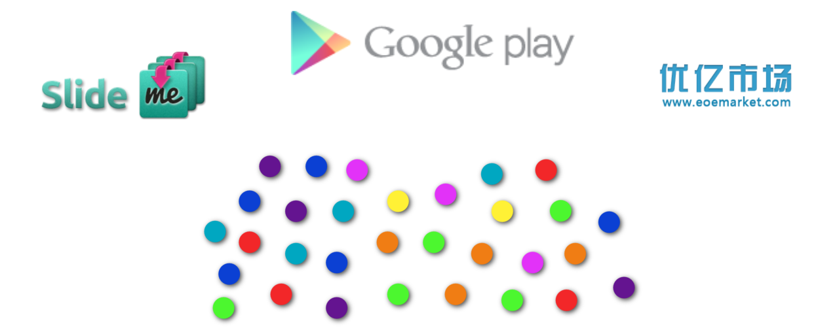
Dataset – Clone Clusters
265,000 apps from 17 markets

Slide 9
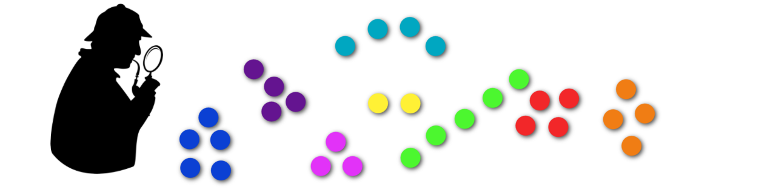
Dataset – Clone Clusters
[Crussell ESORICS 2013]
>5,000 clusters of similar apps
>44,000 unique apps

Slide 10
Dataset – Clone Clusters
[Crussell ESORICS 2013]
>5,000 clusters of similar apps
>44,000 unique apps
Likely clones

Slide 11
Characteristics of Cloned Apps

Slide 12
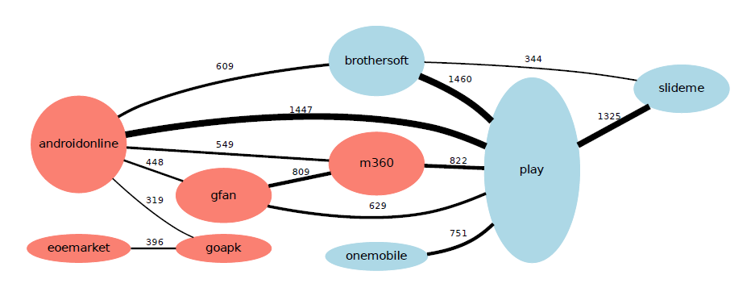
Cloning between Markets
androidonline
play

Slide 13
How do Plagiarized Apps Impact Developers?

Slide 14
Determining Impact
X
Naïve approach
How many times has this app been cloned?
Our approach
How many use plagiarized apps instead of the original?

Slide 15
Determining Impact
Measuring users running a given app
Determining app ownership
Identifying original app from plagiarized

Slide 16
(we’re not Google)

Slide 17

So… what apps are you running?

Slide 18


Advertising Background
Ad Server
Ad request
Client ID = “bob”
Ad library
Ad URL

Slide 19
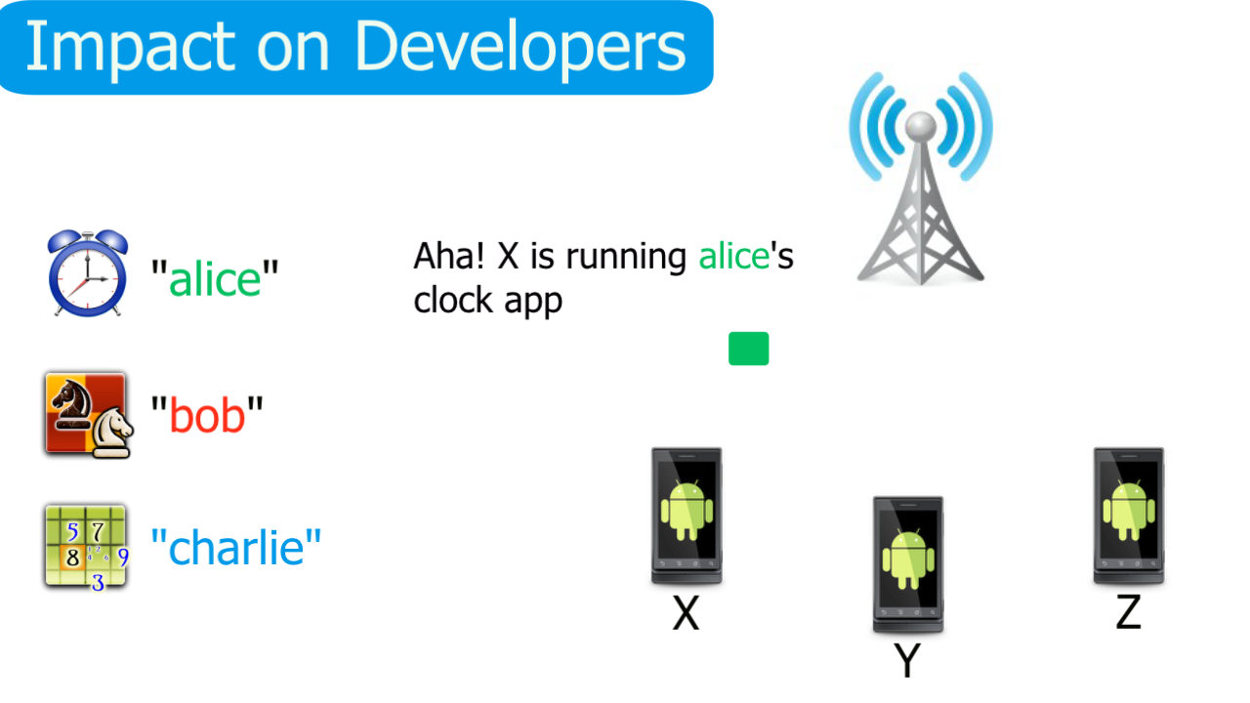
Number of Users Running an App
“bob”
Aha! Bob’s app is being run.

Slide 20
Dataset – Network Traffic
Major U.S. Cellular Provider
2.6 billion packets in 12 days
All user-identifying info removed

Slide 21
Determine Ownership of Apps
Owners may have multiple dev accounts
On one or multiple markets
Apps that share an owner should not be considered plagiarized

Slide 22







Determine Ownership of Apps
Phase 1 – Market/Dev Account

Slide 23
Determine Ownership of Apps
Phase 1 – Market/Dev Account

Slide 24
Determine Ownership of Apps
Phase 2 - Signature

Slide 25



Determine Ownership of Apps
Phase 2 - Signature

Slide 26
Determine Ownership of Apps
Phase 2 - Signature

Slide 27
Determine Ownership of Apps
Phase 3 – Client IDs

Slide 28
Determine Ownership of Apps
Phase 3 – Client IDs

Slide 29
Determine Ownership of Apps
Phase 3 – Client IDs

Slide 30
Determine Ownership of Apps
Phase 3 – Client IDs

Slide 31
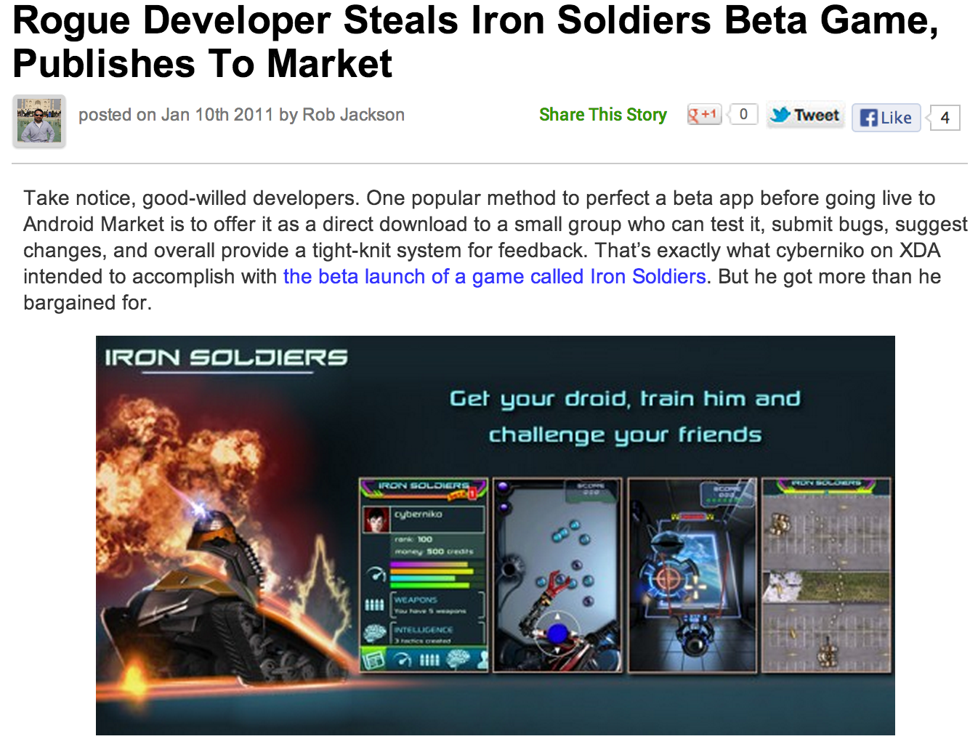
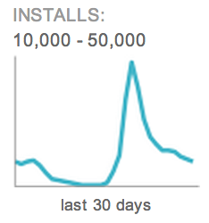
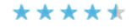
Identifying Original Apps:
Naïve Approaches
Date first uploaded to the market
Popularity
Installs
Rating
Code size

Slide 32
Determining Original vs Clones
Goal: give lower bound
An Example Cluster
Impressions
Alice
20 impressions
20%
Bob
30 impressions
50%
Charlie
50 impressions
30%

Slide 33
Determining Original vs Clones
Goal: give lower bound
Estimated Loss
Impressions
20%
50%
50%
30%
50%

Slide 34
Determining Original vs Clones
Goal: give lower bound
Estimated Loss
Real Loss
20%
50%
50%
30%
50%

Slide 35
Determining Original vs Clones
Goal: give lower bound
Estimated Loss
Real Loss
50%
70%
30%
50%

Slide 36
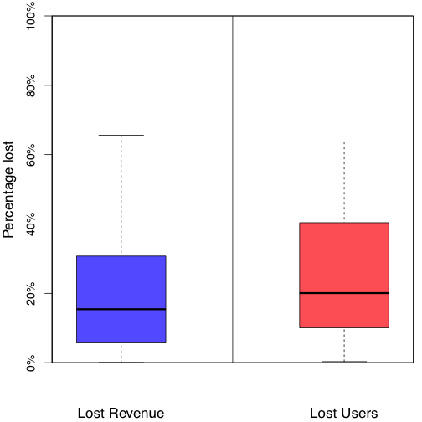
Percent Revenue/Users Lost

Slide 37
Suggestions for Reducing Cloning
Developers
Proguard, License Verification Library (LVL)
Markets
Use tools to detect cloned apps
Adjust market registration fee
Ad providers
Vet developers

Slide 38
Conclusion
First large scale study on impact of Android application plagiarism
Combine
Static analysis for clone detection
Network analysis for revenue loss measurement
Use client IDs to link both analyses
Coming soon:
sherlockdroid.com

